Slide 1
Calling Google Drive API with OAuth 2.0
You're building a vanilla JS app served by http-server, and want to:
Let the user sign in with Google using OAuth
After login, call the Google Drive API
I'll walk you through this using pure HTML + JS (no Auth0), just using Google's OAuth 2.0 and Drive API directly.

Slide 2
Overview of What You Need
Create a Google OAuth 2.0 Project -> Client ID
Serve your app locally with http-server
Use the Google Identity Services SDK
Request OAuth scopes
Use the access token to call Google Drive API

Slide 3
1. Setup Google OAuth
Go to Google Cloud Console (https://console.cloud.google.com/)
Create or select a project
Enable Google Drive API under APIs & Services > Library
Go to APIs & Services > Credentials
Click Create Credentials > OAuth 2.0 Client ID
Type: Web Application
Add http://localhost:8080 as an Authorized JavaScript origin
Save the Client ID.

Slide 4
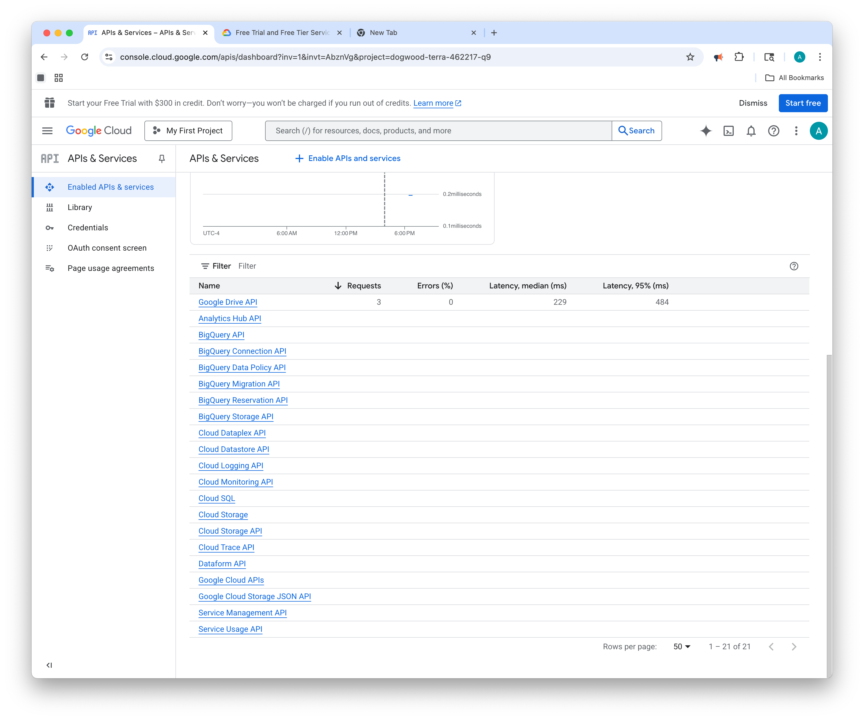
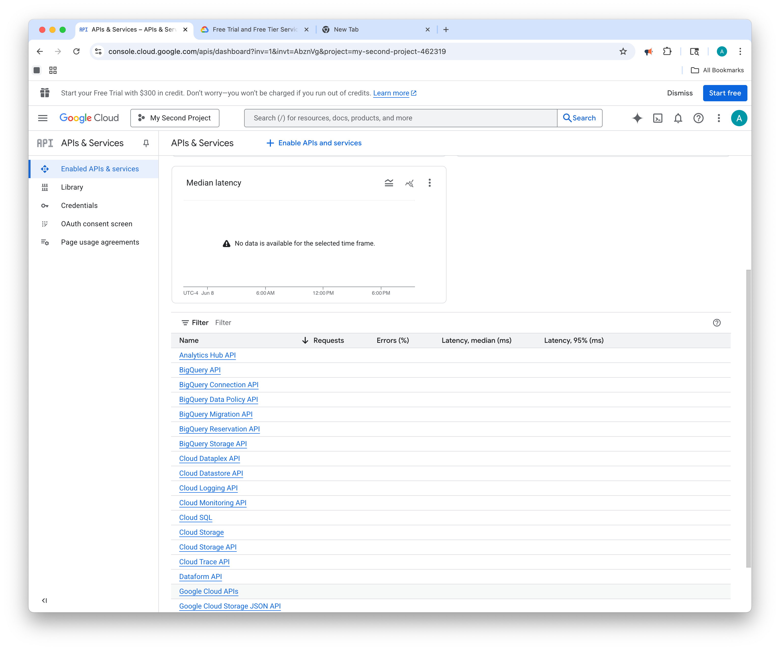
Different projects have different APIs enabled

Slide 5
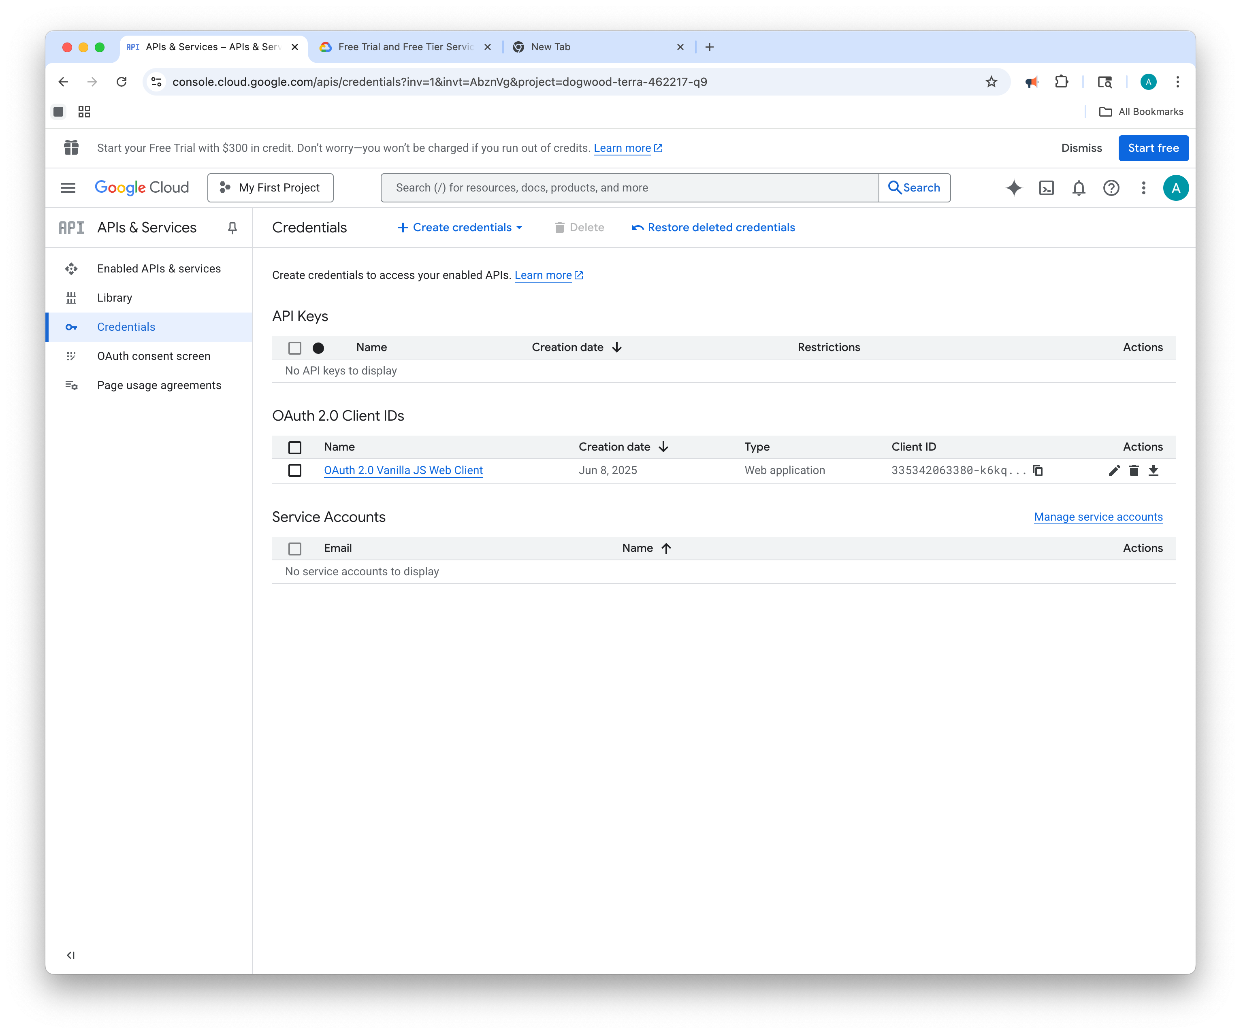
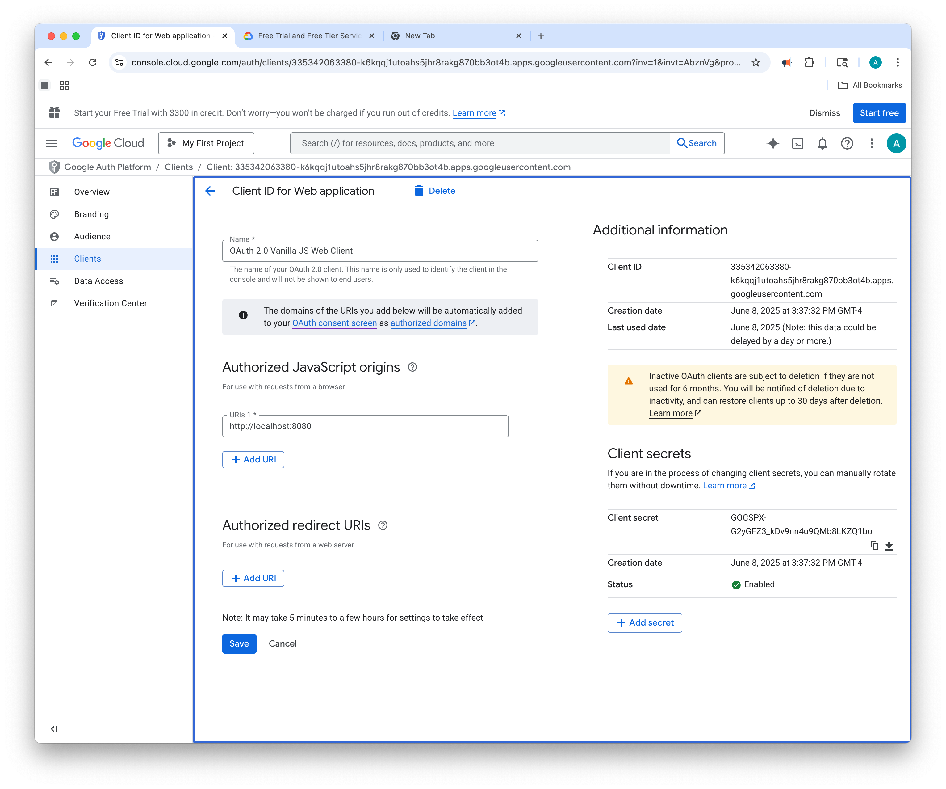
Credentials -> Create Credential (API Keys, OAuth Client or Service Account) Or OAuth Consent Screen -> Clients

Slide 6
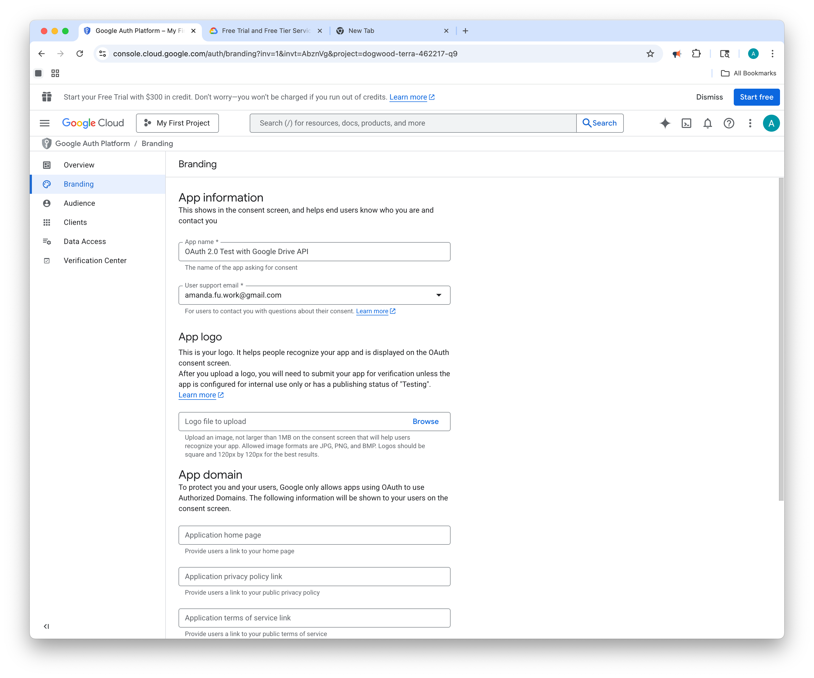
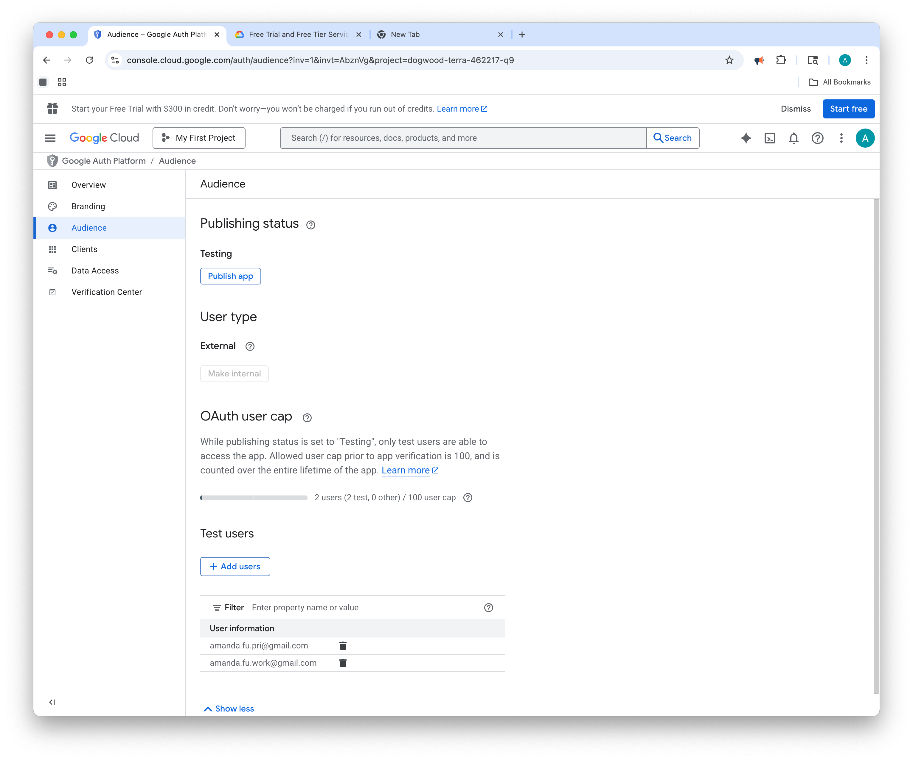
Branding (App name …)and Audience (Add test users or publish)

Slide 7
2. Web Application (served with http-server)
My-app
Index.html
script.js
npx http-server -p 8080
Index.html
<!DOCTYPE html>
<html lang="en">
<head>
<meta charset="UTF-8">
<title>Google Drive Access</title>
<script src="https://accounts.google.com/gsi/client" async defer></script>
</head>
<body>
<h2>Sign in with Google</h2>
<button id="login">Login with Google</button>
<pre id="output"></pre>
<script src="script.js"></script>
</body>
</html>

Slide 8
script.js
const CLIENT_ID = 'YOUR_CLIENT_ID_HERE'; // ← paste from Google Cloud Console
const SCOPES = 'https://www.googleapis.com/auth/drive.metadata.readonly';
let tokenClient;
let accessToken = null;
document.getElementById('login').onclick = () => {
tokenClient = google.accounts.oauth2.initTokenClient({
client_id: CLIENT_ID,
scope: SCOPES,
callback: (response) => {
if (response.error) {
console.error(response);
return;
}
accessToken = response.access_token;
listDriveFiles(); // Call Drive API after login
},
});
tokenClient.requestAccessToken();
};
function listDriveFiles() {
fetch('https://www.googleapis.com/drive/v3/files', {
headers: {
Authorization: `Bearer ${accessToken}`
}
})
.then(res => res.json())
.then(data => {
document.getElementById('output').textContent = JSON.stringify(data, null, 2);
})
.catch(err => console.error('API error:', err));
}

Slide 9
Notes
This uses OAuth Implicit flow (access token in browser memory).
For production, you should implement refresh tokens via backend (Authorization Code flow).
You must serve over HTTPS in production or use localhost during development.

